Slide 1


SKILLS- EXCHANGE

Slide 2

WHAT IS THE SKILL-EXCHANGE WEBSITE?
A PLATFORM WHERE PEOPLE TEACH AND LEARN SKILLS BY EXCHANGING TIME, NOT MONEY.
Example: You teach painting for 1 hour → You earn 1 hour → You use that hour to learn coding, cooking, yoga, etc.

Slide 3

PURPOSE OF THE WEBSITE
Make learning affordable for everyone
Help users find local or online skill partners
Build a community-driven learning network

Slide 4

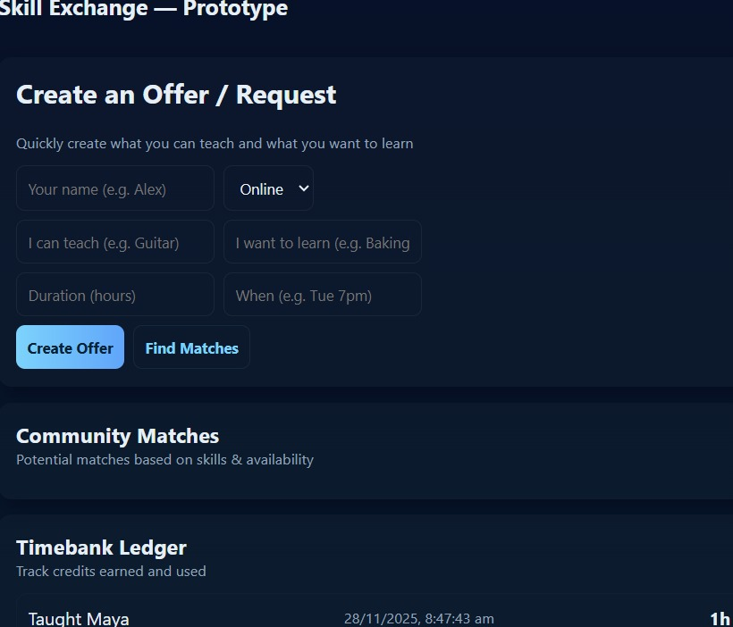
HOW THE WEBSITE WORKS
Users create a profile
Add skills they can teach
Add skills they want to learn
System matches two users
They schedule the session
Time credit is transferred after the session

Slide 5

ADVANTAGES OF THE PLATFORM
NO MONEY NEEDED
Learn at your own pace
Build community connections
Opportunity to teach & showcase talents
Access to diverse skills worldwide
T

Slide 6
CONCLUSION
The Skill-Exchange Website helps people learn new skills without spending money. Users teach what they know and learn what they want in return. It is easy to use, safe, and good for everyone. The platform encourages sharing, learning, and building a helpful community.

Slide 7

THANK YOU

